Slide 1

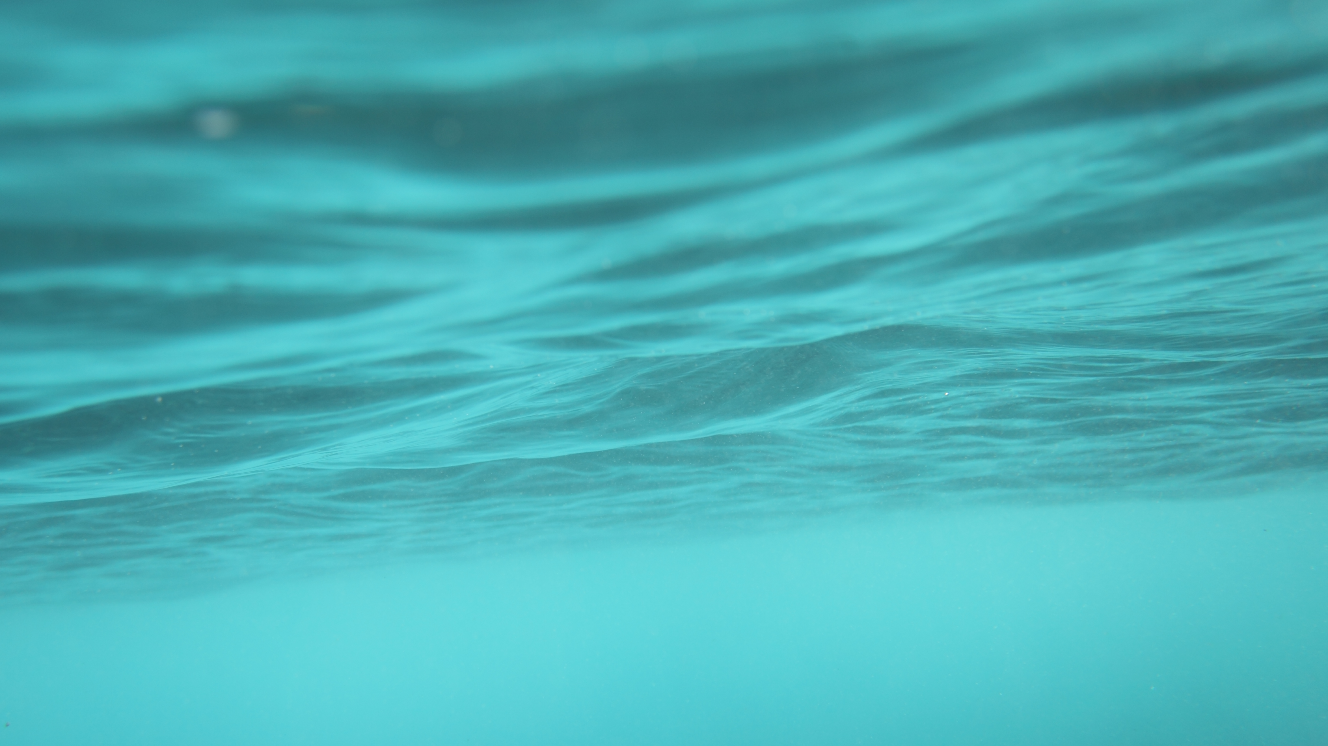
Hydrosphere

Slide 2
It refers to water on, under and over the surface of the Earth.

Slide 3
Water cycle
There is always the same amount of water on Earth.
Water appears in different states (liquid, gas or solid form).
Water continually move between the atmosphere, the oceans and the continents.

Slide 6
This continual movement is called the water cycle
The main parts of this cycle are-
•evaporation (and transpiration)
•condensation
•precipitation
•collection

Slide 9
Evaporation is when the sun heats up water in rivers or lakes or the ocean and turns it into vapor or steam. The water vapor or steam leaves the river, lake or ocean and goes into the air.
Condensation:Water vapor in the air gets cold and changes back into liquid, forming clouds. This is called condensation.
Precipitation occurs when so much water has condensed that the
air cannot hold it anymore. The clouds get heavy and water falls
back to the earth in the form of rain.

Slide 10
Collection:When water falls back to earth as precipitation, it may fall back in the oceans, lakes or rivers or it may end up on land. When it ends up on land, it will either soak into the earth and
become part of the ―ground water that plants and animals use to drink or it may run over the soil and collect in the oceans, lakes or rivers where the cycle starts.

Slide 11
Types of water
Saltwater: 97% of the Earth’s water is saltwater located mainly in the oceans and seas.
Freshwater: 3% is fresh water located on continents and islands (river,lakes, groundwater, water vapour…)

Slide 13
Water can be found in
Oceans: vast masses of saltwater that separate the continents.
Seas: oceanic waters that are close to continents and not as
deep as oceans.
Rivers: continuously flowing currents of water that flow into
seas, lakes and other rivers.

Slide 14
Tributary: a river that flows into another river.
Groundwater: rainwater that infiltrates rocks and soil into the Earth’s surface.
Aquifers: stores of groundwater that accumulate underground on top of impermeable layers of rock.
Wells: holes that men do into the Earth’s surface to bring underground water to the surface.

Slide 15
Glaciers: huge mass of ice, formed from compacted snow, slowly flowing over a land mass.
Ice caps: huge mass of ice and snow that permanently cover the poles of the Earth.
Lakes: large bodies of water that accumulate in inland basins. They receive water from rivers, precipitation and groundwater.

Slide 16
Uneven water distribution
Water is essential for life. Humans can only drink fresh water that needs to be purified.
As most fresh water is trapped in ice and glaciers there is not
much water for human consumption left.
So we need to recycle water to assure our lifelihood.

Slide 17
Although water is found in a considerable amount in temperate and tropical regions where there is a lot of precipitation there is an uneven distribution of water on the Earth.
Floods: the inundation of land that is normally dry through the overflowing of a body of water
Droughts: a long period of scanty or low rainfall that normally affects growing or living conditions.

Slide 18
Lithosphere
The lithosphere is the solid, outer part of the Earth. The lithosphere includes the brittle upper portion of the mantle and the crust, the outermost layers of Earth’s structure. It is bounded by the atmosphere above and the asthenosphere (another part of the upper mantle) below.
Although the rocks of the lithosphere are still considered elastic, they are not viscous. The asthenosphere is viscous.

Slide 19
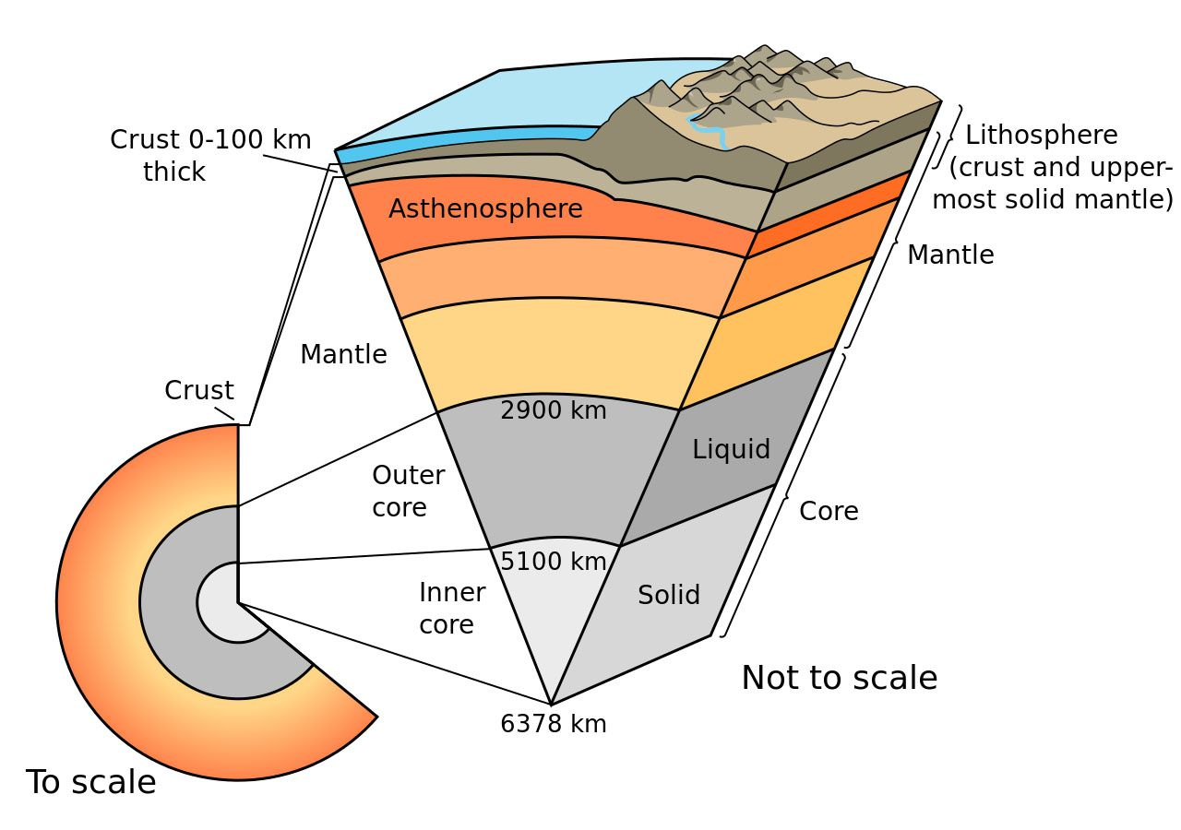

Slide 20
There are two types of lithosphere: oceanic lithosphere and continental lithosphere. Oceanic lithosphere is associated with oceanic crust, and is slightly denser than continental lithosphere.

Slide 21
Plate Tectonics
The most well-known feature associated with Earth’s lithosphere is tectonic activity. Tectonic activity describes the interaction of the huge slabs of lithosphere called tectonic plates.
The lithosphere is divided into tectonic plates including the North American, Caribbean, South American, Scotia, Antarctic, Eurasian, Arabian, African, Indian, Philippine, Australian, Pacific, Juan de Fuca, Cocos, and Nazca.

Slide 22
Most tectonic activity takes place at the boundaries of these plates, where they may collide, tear apart, or slide against each other. The movement of tectonic plates is made possible by thermal energy (heat) from the mantle part of the lithosphere. Thermal energy makes the rocks of the lithosphere more elastic.
Tectonic activity is responsible for some of Earth's most dramatic geologic events: earthquakes, volcanoes, orogeny (mountain-building), and deep ocean trenches can all be formed by tectonic activity in the lithosphere.

Slide 23
Biosphere
This is the region of the earth where life exists and includes a global area extending from about 10,000 meter below sea level to 6000 meter above sea level.
Thus the biosphere covers the entire area of living organisms and their interactions with the other segments of the environment, like lithosphere, hydrosphere, and atmosphere.
The most distinguishing feature of the biosphere is that it supports life.

Slide 24
According to an estimate the biosphere contains more than 3.5 lac species of plants including algae, fungi etc. and more than 11 million species of animals. The biosphere supplies all the essential requirements of life like light, heat, air, water, food and living space for all these species.
Since biosphere is very large and complex, therefore , for better understanding , it is divided into smaller units called “ecosystem”

